Slide 1
User authentication and password policies
Authentication

Slide 2
Authentication is the process in which a user is identified and verified to a system. It requires presenting some sort of identity and credentials, such as a user name and password.
The system then compares the credentials against the configured authentication service. If the credentials match and the user account is active, then the user is authenticated.

Slide 3
Different types of user authentication in Linux
CentOS 7 supports various types of user authentication mechanisms, including:
Password Authentication: This is the most common form of authentication, where users provide a username and password to gain access to the system.
Public Key Authentication (SSH keys): Users can generate a public-private key pair, and the public key is stored on the server. When the user attempts to connect via SSH, the server verifies the user's identity by matching the private key with the stored public key.

Slide 4
3. Kerberos Authentication: Kerberos is a network authentication protocol that uses tickets to allow nodes communicating over a non-secure network to prove their identity to one another securely. CentOS 7 supports Kerberos authentication, which is commonly used in enterprise environments.
4. LDAP Authentication: Lightweight Directory Access Protocol (LDAP) is a protocol for accessing and maintaining distributed directory information services over an IP network. CentOS 7 can be configured to authenticate users against an LDAP server, which is often used in large organizations to manage user accounts centrally.

Slide 5
Authentication is the verification of the identity of an entity, such as a user, to a system.
A user logs in by providing a user name and a password, and the operating system
authenticates the user's identity by comparing this information to data stored on the system. If
the login credentials match and the user account is active, the user is authenticated and can
successfully access the system.

Slide 6
PASSWORD POLICIES
Password management is an important security measure for any Linux system. Without a secure password, unauthorized people can access the system, leaving it vulnerable to malicious attacks. It’s therefore essential to define password policies that force the user to consider a complex one that is difficult to guess or crack.

Slide 7
Password Policy Configuration in CentOS
Password policy configurations will contain:
1. Password Length
2. Password Complexity
3. Password expiration
4. Deny past used passwords.

Slide 8
# nano /etc/pam.d/system-auth
# nano /etc/pam.d/password-auth
Centos 7 command for setting up password length:
# authconfig --passminlen=8 –update
To verify configured password length after above command execution
# grep "^minlen" /etc/security/pwquality.conf

Slide 9


Slide 10
Password Complexity
Password complexity policy allow user to set complex password this policy allow user to use password which contain upper-case character, lower-case character and special or symbol character. In below steps I will configure one upper-case, lower-case, and a special character in the password. You can set any number of maximum allowed upper-case, lower-case, and other letters in your password.

Slide 11
set at least one lower-case character for password:
# authconfig --enablereqlower –update
To set at least one upper-case character for password:
# authconfig --enablerequpper –update
To set at least one digit for password:
# authconfig --enablereqdigit –update
To set at least one other or symbol character for password:
# authconfig --enablereqother –update

Slide 12
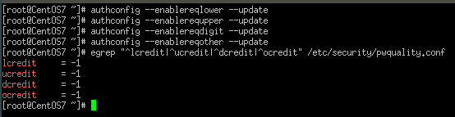
To verify password complexity setting after running above command
Egrep "^lcredit|^ucredit|^dcredit|^ocredit" /etc/security/pwquality.conf

Slide 13
Password expiration
Password expiration policy prompt user to change his/her password before certain days of expiration to enforce this policy CentOS 6 / RHEL 6 and CentOS 7 / RHEL 7 has a file /etc/login.defs. This file contain below parameters which allow System Administrator to set policy:

Slide 14
• PASS_MAX_DAYS: Maximum number of days a password may be used.
• PASS_MIN_DAYS: Minimum number of days allowed between password changes.
• PASS_WARN_AGE: Number of days warning given before a password expires.
To enforce this password in these CentOS 6 / RHEL 6 and CentOS 7 / RHEL 7 machines locate the below parameters in /etc/login.defs file and provide number of days as per your requirement:

Slide 15
PASS_MAX_DAYS
PASS_MIN_DAYS
PASS_WARN_AGE

Slide 16



Slide 17
Note: This above password expiration policy only applicable to newly created users whereas above password expiration policy won’t be applicable to existing user(s) thus you need to set this policy manually to existing user(s) from chage command you can set policy manually:
• To set Maximum password days: chage -M <no. of days> <username>
• To set Minimum password days: chage -m <no. of days> <username>
• To set number of warning days before password expire: chage -W <no. of days> <username>
Sample output:

Slide 18
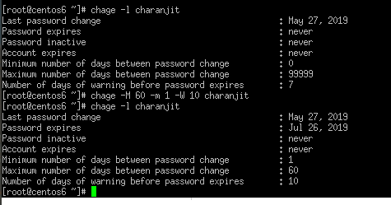

Slide 19
Deny past used passwords
Deny past used passwords policy disallow users to set their password which were used in past. This make password more complicated by making it non guessable for attacker. In both CentOS 6 / RHEL 6 and CentOS 7 / RHEL 7 configuration is same. In both OSes you need to configure these files /etc/pam.d/system-auth and /etc/pam.d/password-auth locate and make below entry:

Slide 20
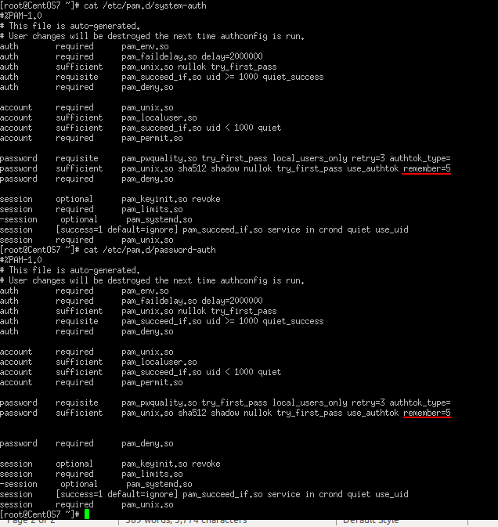
password sufficient pam_unix.so sha512 shadow nullok try_first_pass use_authtok remember=5

